Slide 1

Solving Open AI’s Car Racing Problem Using DQN
Supriyo Sadhya
A02345100

Slide 2
Summary
The need of this study is to explore a real-world application of machine learning that is related to self driving vehicles.
OpenAI’s CarRacing-v2 2D environment and a Deep Q-Network to train our agent.

Slide 3
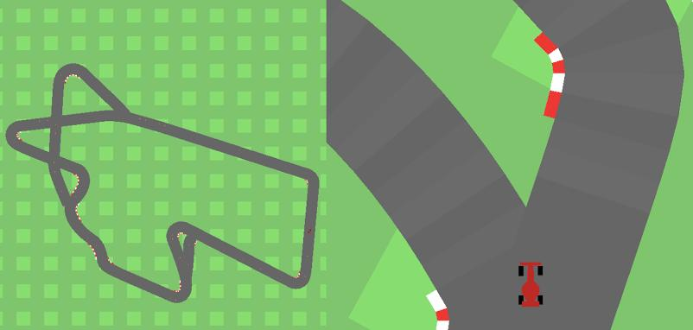
Environment
CarRacing-v2 environment state consists of 96x96 RGB image.
The reward is equal to -0.1 for each frame and +1000/N
Continuous space has 3 actions: steering (-1 is full left, +1 is full right),gas,break

Slide 4
Methods
Discretized the continuous action space into 12 action states.
Used CNN for our DQN Model.
DQN was used with experience replay and with and without target network.
DQN with target network produced best results.

Slide 5
Network(CNN)
Flattened(512)
Convolutional Layer1
(3,16)
Max pool
(2,2)
Convolutional Layer2
(16,32)
Max pool
(2,2)

Slide 6
Network(Dense Layers)
Layer1(512)
Layer2(256)
Output(12)

Slide 7
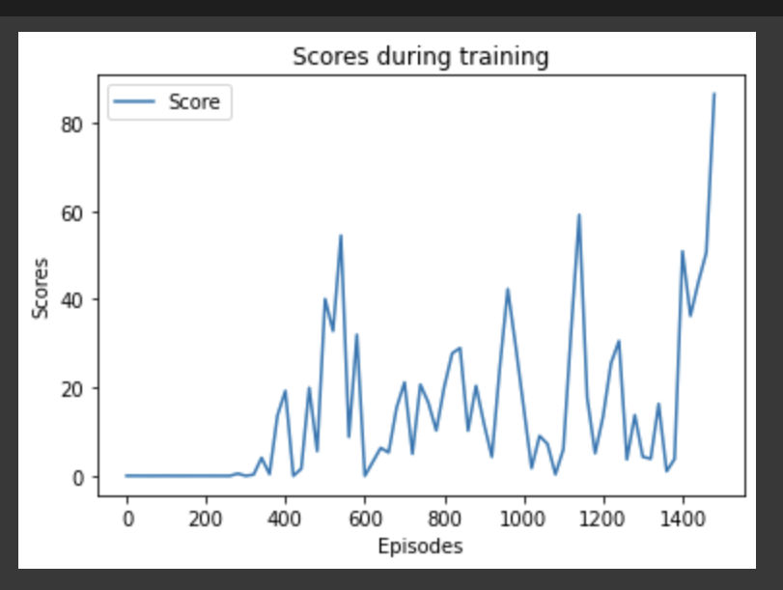
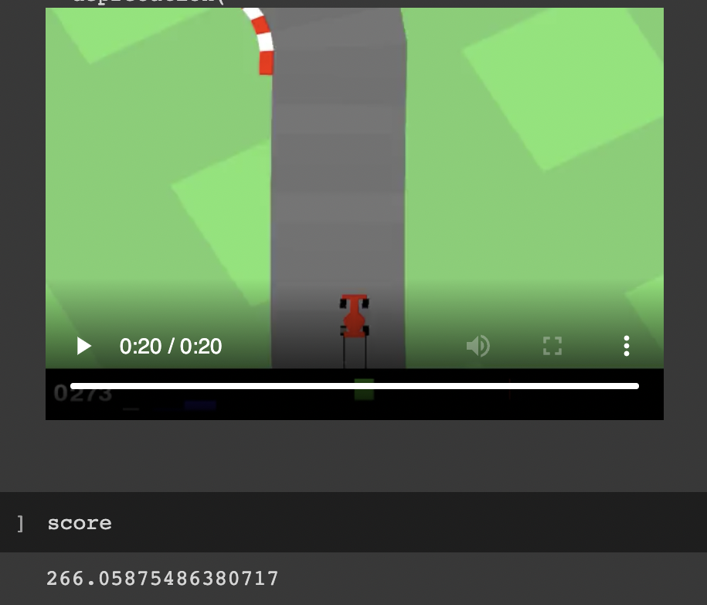
Results
Learning curve for DQN with target network
Agent result for DQN with target network

Slide 8
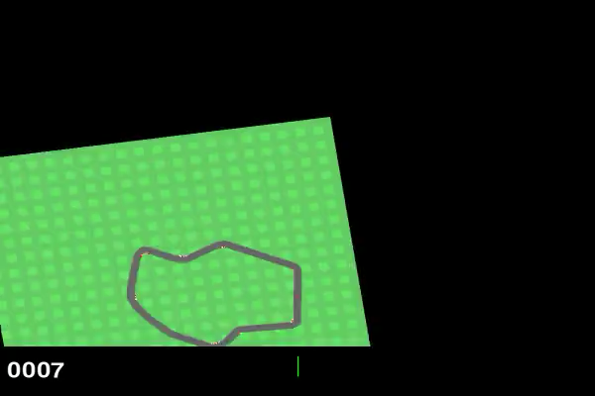
Working Agent
DQN with target network

Slide 9
Comparison
Used a Double DQN model for comparison.
Double DQN is said to solve overestimation problem of DQN.
But in our case DQN learns the optimal policy much faster.
Double DQN performs poorly.

Slide 10
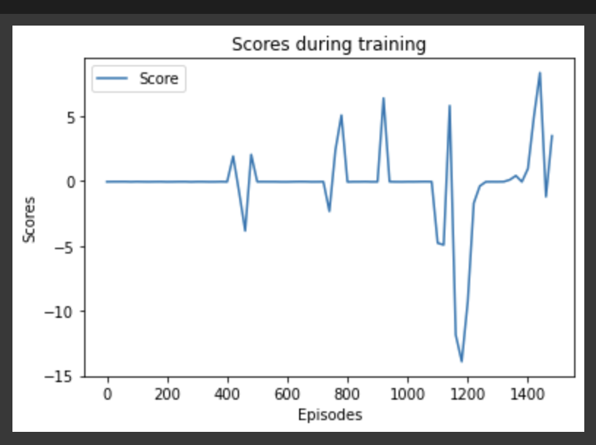
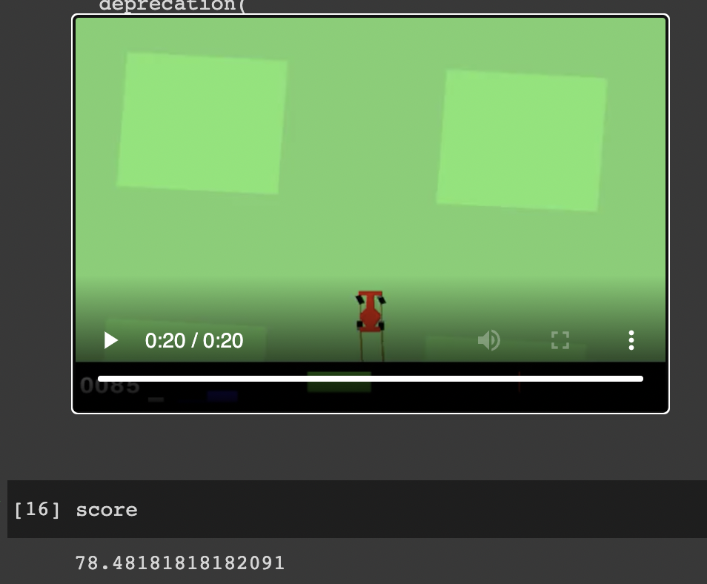
Results (Double DQN)
Learning curve
Agent Result

Slide 11
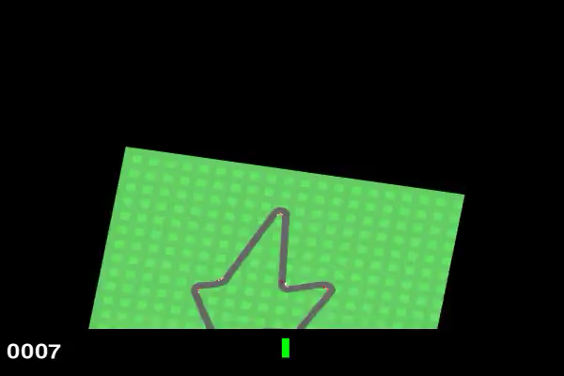
Working Agent(Double DQN)

Slide 12
Conclusion
DQN with experience replay and target network produces the best results.
The discretization of action space and the exploration rate heavily influencing the learning of the agent.
Double DQN actually performs poorly given a set number of episodes.
For further improvement we can try out other algorithms like PPO.

